Slide 1


Latent Class Analysis
Another way of examining interrelationships

Slide 2
Install LCA for SPSS
Extensions → Extension Hub → search ‘latent’ install STATS_LATENT_CLASS
It is available under ‘Analyze’ → Loglinear → Latent Class Analysis
If you have version 27 or less you need to follow alternative instructions ☹

Slide 3
Categories of statistical models
 |  |  | Outcome/Dependent Variable
 |  |  | Continuous | Categorical
Predictor Variables | Observed | Continuous | Regression | Logistic
 |  | Categorical | MANOVA/Regression | Non-parametric (e.g. chi-square)
 | Latent | Continuous | Factor Analysis | Item Response Theory
 |  | Categorical | Latent Profile Analysis | Latent Class Analysis
Finite Mixture Models

Slide 4
What We Will Cover
When is latent class analysis (LCA) model useful?
What is the LCA model its underlying assumptions?
How to run the model via R in SPSS
How are LCA parameters interpreted?
Incorporating covariates into the measurement model
How to determine model fit?

Slide 5
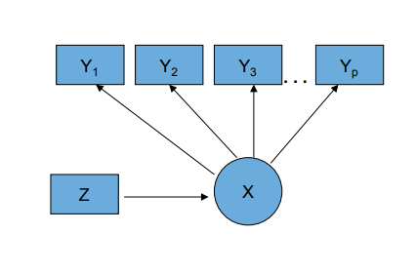
The Latent Class Model
Observed Categorical Items (Y’s)
Categorical Latent Class Variable (C)
Continuous or Categorical Covariates (Z)
C
Notes:
Note: the only difference between the Latent Class and Latent Profile models is that the profile models have continuous Y’s and we are not estimating conditional class probabilities we are estimating conditional means of continuous variables

Slide 6
Note: Many types of latent variable models
Creating typologies based on item responses***
Multilevel latent class models
Longitudinal latent class models
Growth mixture models
Latent transition (“Hidden Markov”) models
Combinations of the above
E.g., Multilevel latent transition model

Slide 7
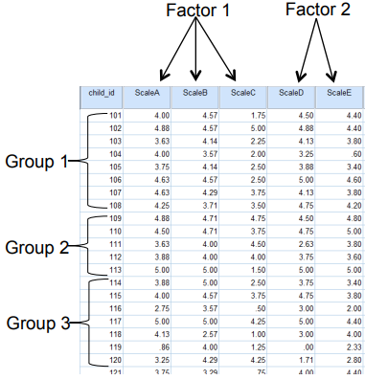
Person centered v. Variable centered analysis
LCA is a person-centered approach
Variable centered
Correlations/covariances are of interest
Structure among columns (e.g., factor)
Person centered
Structure among rows is of interest
Seeks to group individuals based on shared characteristics
Goal: identify qualitatively distinct groups

Slide 8

Mixture Models
LCA and LPA are special cases of mixture models
Modeling a “mixture” of sub-groups within a population
Assumes
“Finite” number of homogeneous categories (i.e., classes)
The population is a mixture of qualitatively different groups of individuals
Groups can be identified based on similarities in response patterns
RQ: Can we identify subgroups of individuals who fit various ‘profiles’
Similar in some ways to FA but very different!
Notes:
In statistics, a mixture model is a probabilistic model for representing the presence of subpopulations within an overall population, without requiring that an observed data set should identify the sub-population to which an individual observation belongs.

Slide 9
Item | Class 1: Family member illness and death N = 858 (16.31%) | Class 2: Multiple overlapping adversity N = 275 (5.23%) | Class 3: Financial insecurity N = 591 (11.22%) | Class 4: Residential Instability and Family Conflict N = 455 (8.65%) | Class 5: Low Material Hardship N = 3083 (58.59%)
Family Member Hospitalized | 0.782 | 0.62 | 0.172 | 0.14 | 0.092
Divorce or Separation | 0.042 | 0.371 | 0.041 | 0.286 | 0.009
Moved to a different address | 0.434 | 0.812 | 0.504 | 0.526 | 0.281
Partner Lost Job | 0.044 | 0.567 | 0.389 | 0.075 | 0.013
Lost Job | 0.027 | 0.571 | 0.272 | 0.127 | 0.018
Work hours or pay cut | 0.103 | 0.579 | 0.706 | 0.027 | 0.036
Problems paying rent or mortgage | 0.083 | 0.849 | 0.506 | 0.343 | 0.026
Partner away | 0.08 | 0.1 | 0.054 | 0.086 | 0.039
Partner arguments | 0.163 | 0.718 | 0.356 | 0.736 | 0.069
Partner did not want pregnancy | 0.045 | 0.269 | 0.05 | 0.318 | 0.009
Someone close had a drug or alcohol problem | 0.199 | 0.6 | 0.091 | 0.332 | 0.025
Experienced homelessness | 0.001 | 0.296 | 0.017 | 0.034 | 0.002
Close person died | 0.703 | 0.575 | 0.105 | 0.103 | 0.055

Slide 10

Two key model assumptions
1. MIXTURE ASSUMPTION
There is a latent categorical variable (i.e., unobserved) that consists of a finite number of types, i.e., classes
2. LOCAL INDEPENDENCE ASSUMPTION
Within classes, items are independent

Slide 11
Example
If we run an LCA on these indicators of PTSD, what does the mixture assumption imply?
Hypervigilance
Inability to sleep
Nightmares
Avoidance of people
Avoidance of places
Difficulty concentrating
Assume that these two variables ‘load’ on the same latent variable: avoidance of people and avoidance of places? What does the local independence assumption mean?

Slide 12
Outputs and paramters
Seeks homogeneous subpopulations
Parameters used to characterize latent classes
Class prevalence
Probability of endorsing each item within each class
The patterning of the probabilities will suggest that the classes either differ by degree and or by substance

Slide 13
Motivating Example: Class differences by degree
Different types of victimization, psychological and psychosocial risk factors are often co-occurring
The Frailty construct in aging research
Latent: degree of frailty meaning how frail on older person is on multiple items
Manifest: criteria (as derived from the literature)
Weight loss above threshold
Low energy expenditure
Low walking speed
Weakness beyond threshold
Exhaustion
RQ?

Slide 14
Bandeen-Roche et al. (2006)
Criterion/Item | 3-Class Model of Frailty
 | Class 1 | Class 2 | Class 3
Weight Loss | .072 | .11 | .54
Weakness | .029 | .26 | .77
Slowness | .004 | .45 | .85
Low Physical Activity | .000 | .28 | .70
Exhaustion | .027 | .16 | .56
Class prevalence (%) | 39.2 | 53.6 | 7.2
Low
Medium
High
The items are no longer correlated w/in each class i.e.,
they are conditionally independent
The latent class accounts for the observed interrelationships
How would you interpret and label these classes?
Notes:
These researchers found 3 classes best described the frailty concept
Of note is that these classes differ by degree – high medium and low

Slide 15

2-class LC model with 3 items
Each item is coded as 1 = Yes and 2 = No
How many possible combinations of the responses are there, and what are they?
Model
The model returns each pattern and the probability of observing that pattern
(Yes, Yes, Yes) with probability p
(Yes, No, Yes)
…
Etc

Slide 16
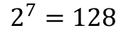
How many patterns?
2
2
2
2
2
2
2
$$2^{7}=128$$
possible response patterns

Slide 17
Evaluating Model Fit/Selecting the # of classes
a priori theory
Chi-Square goodness of fit
Classification error
Information Statistics – AIC, BIC, others
Lo-Mendell-Rubin (LMR) – (normal Y)
Bootstrapped Likelihood Ratio Test

Slide 18
Entropy
Similar to our classification ‘error’ table from logistic regression analysis
Measures classification error
Ranges between 0 – 1 (1 = perfect classification)

Slide 19
Information Criterion Statistics
AIC: -2LL + 2s
BIC = -2LL + s*log(N)
where s = # of parameters, N = sample size
Here, as in all SEM models, smaller values are better
BIC is typically preferred
In LVM, the BIC statistic is the gold standard

Slide 20
Likelihood Ratio Test
Recall: only use with nested models
LCA seems nested but its not for purposes of LRT

Slide 21
1. Evaluating Model Fit: Information Criteria
for model comparison
parsimony versus fit
Common criteria
BIC(LL) = -2LL + ln(N) * Npar
AIC(LL) = -2LL + 2 * Npar

Slide 22
Model fit Comparisons
 | L2 | BIC | AIC | df | P-value
1-C
2-C
3-C
4-C
5-C
6-C
Note: Can make elbow plot of AIC/BIC etc to show lowest value
Notes:
Note: the SPSS module does not give us all of these numbers, but it gives the most important ones

Slide 23

Example
Political Participation in Greek Elections

Slide 24
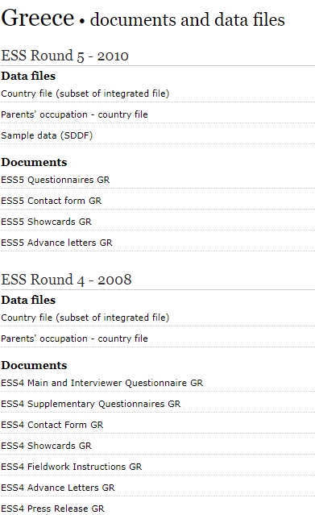
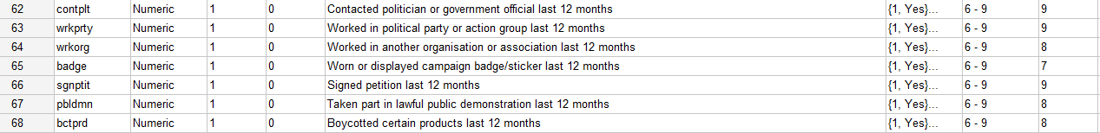
Political Participation
There are different ways of trying to improve things in [Greece] or help prevent things from going wrong. During the last 12 months, have you done any of the following? (1 = Yes, 2 = No)
A priori, what do you expect the classes to look like?

Slide 25
Political Participation in Greek Elections
Let’s estimate the model
Open the file ESS4GR_short.SAV in SPSS
We will estimate between 1 and 5 classes and replicate the table on the following slide
Note: this always is done first

Slide 26
Model fit evaluation: summary
Compare models with different number of classes using BIC, AIC, bootstrapped L2
Evaluate different solutions: if nothing much changes, or very small classes result, fit may not be as useful

Slide 27
Model fit Comparisons
Model Fit Statistics
 | L2 | BIC | AIC | df
1-C | -3380.286 | 6814.026 | 6774.571686 | 120.000000
2-C | -2866.697077 | 5847.938198 | 5763.394154 | 112.000000
3-C | -2828.516273 | 5832.666747 | 5703.032546 | 104.000000
4-C | -2793.065250 | 5822.854858 | 5648.130500 | 96.000000
5-C | -2786.013935 | 5869.842384 | 5650.027869 | 88.000000
6-C
Stop when BIC/AIC for the c+1 class is bigger than the c class model
Note: Can make elbow plot of AIC/BIC etc to show lowest value

Slide 28
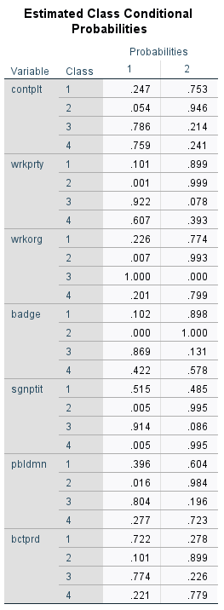
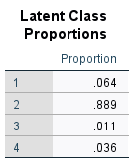
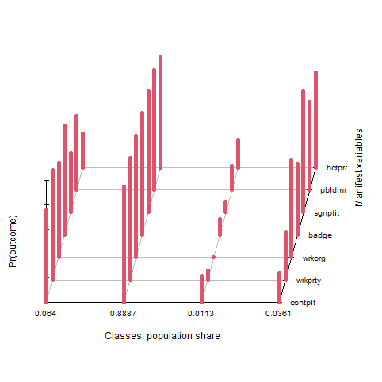
Output
This output needs to be transformed and plotted in much friendlier formats
The Estimated Class Conditional Probabilities give the conditional probability of endorsing a given question (about political participation) conditional on membership in latent class 1, 2, 3 and 4
The Latent Class Proportions table gives the proportions of respondents who are in each class

Slide 29
Results
Indirect
None
All
Direct
 | Class 3 |  | Class 4 |  | Class 2 |  | Class 1
 | Yes | No | Yes | No | Yes | No | Yes | No
Contacted POL. | 0.25 | 0.75 | 0.05 | 0.95 | 0.79 | 0.21 | 0.76 | 0.24
Worked in PP | 0.1 | 0.9 | 0 | 1 | 0.92 | 0.08 | 0.61 | 0.39
Worked in Org | 0.23 | 0.77 | 0.01 | 0.99 | 1 | 0 | 0.2 | 0.8
Wore badge/sticker | 0.1 | 0.9 | 0 | 1 | 0.87 | 0.13 | 0.42 | 0.58
Signed Pet. | 0.52 | 0.48 | 0.01 | 0.99 | 0.91 | 0.09 | 0.01 | 0.99
Public Demon. | 0.4 | 0.6 | 0.02 | 0.98 | 0.8 | 0.2 | 0.28 | 0.72
Boycotted Prod. | 0.72 | 0.28 | 0.1 | 0.9 | 0.77 | 0.23 | 0.22 | 0.78
Class % | 6.4% |  | 88.9% |  | 1.1% |  | 3.6%

Slide 30
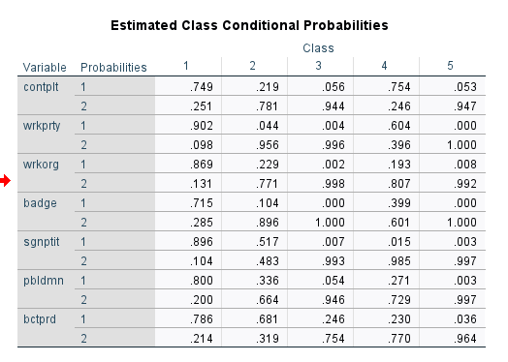
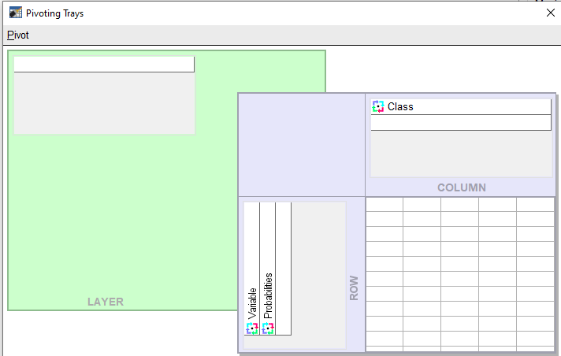
Re-arrange in more interpretable format
Make use of SPSS ‘Pivot Trays’
Recall that 1 = Yes (e.g., the participant contacted a politician) and 2 = No
Analyze patterns within classes to derive Typologies of participation

Slide 31
 | Class 3 | Class 4 | Class 2 | Class 1
contplt | 0.24679 | 0.05415 | 0.7861 | 0.75902
wrkprty | 0.10087 | 0.00114 | 0.9217 | 0.60693
wrkorg | 0.22632 | 0.00657 | 1 | 0.20123
badge | 0.1024 | 0 | 0.86903 | 0.42217
sgnptit | 0.51519 | 0.00528 | 0.91434 | 0.00544
pbldmn | 0.39626 | 0.01633 | 0.80445 | 0.2769
bctprd | 0.72153 | 0.1008 | 0.77395 | 0.22115
Notes:
Note: I have only taken the probability of endorsement (yes) here and omitted No
We don’t use those for the charts

Slide 32
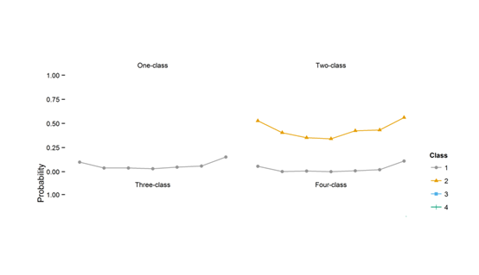
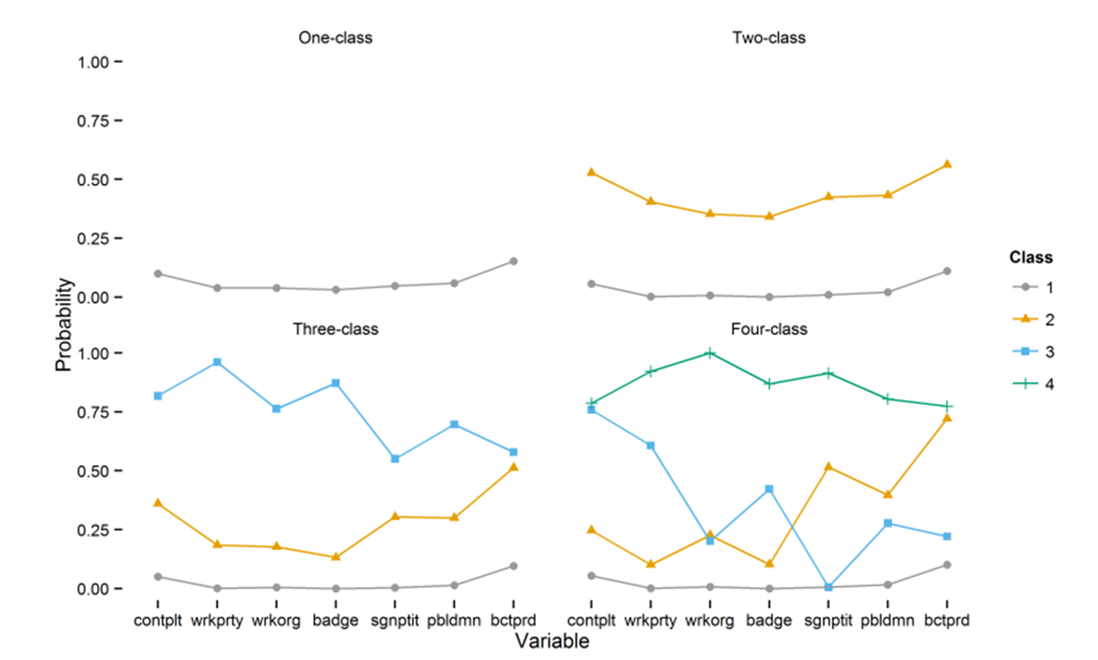

3. Interpreting the results and using substantive criteria

Slide 33

Prediction
We are interested in how the covariate predicts membership in a latent class

Slide 34

Adding covariates
Now we can include covariates to predict membership in each latent class
Note: you must choose the latent classes first, before including covariates!
We are predicting membership in a latent class, 1 = in the class, 0 = not in the class → logistic regression

Slide 35

Gender as Predictive of Latent Class Membership
We have gender as a covariate
We are predicting whether females (males) are more likely to be in class
1 v 2
1 v 3
1 v 4
2 v 4
2 v 3
3 v 4
But, the software selects only one class for comparison (class 1)
What do you expect
Recall we have high, low, direct and indirect…
Notes:
The comparison class is the familiar ‘omitted’ class

Slide 36
Logistic regression refresher
Logistic regression coefficient equals -0.3406
Then log odds ratio of being in class 2 (compared with reference class 1) are -0.3406 smaller for females compared to males
So, odds ratio is smaller by a factor exp(-0.3406) = 0.71
The % change in the odds is [exp(-.3406) – 1] * 100
So, odds are 30% lower for females

Slide 37
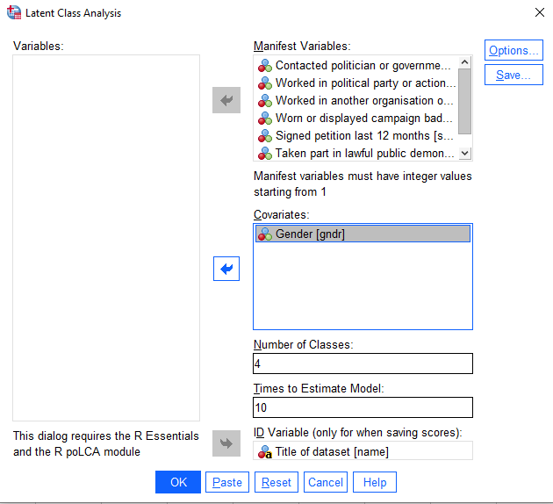
Add ‘gender’ to predict membership in Greek Politics classes

Slide 38
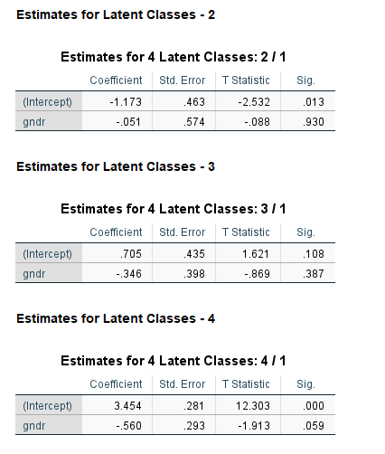
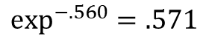
Logistic (Multinomial) Regression Results
Female is 0/Male is 1
The odds of males being in class 2 versus class 1 are no different
The odds of males being in class 3 versus class 1 are no different
The odds of males being in class 4 versus class 1 are significantly less at the p = .10 level. Specifically, the odds of being in class 4 compared to class 1 are .571 times lower for males versus females. Males are more likely than females to do direct forms of political participation compared no political participation.
$$\exp^{−.560}=.571$$

Slide 39
Your turn: ACEs
The National Survey of Children’s Health (NSCH.sav) provides rich data on multiple, intersecting aspects of children’s lives—including physical and mental health, access to quality health care, and the child’s family, neighborhood, school, and social context. The National Survey of Children's Health is funded and directed by the Health Resources and Services Administration (HRSA) Maternal and Child Health Bureau (MCHB). A revised version of the survey was conducted as a mail and web-based survey by the Census Bureau in 2016, 2017, 2018, 2019 and 2020. Among other changes, the 2016 National Survey of Children’s Health started integrating two surveys: the previous NSCH and the National Survey of Children with Special Health Care Needs (NS-CSHCN). See the MCHB website for more information on the 2016, 2017, 2018, 2019 and 2020 National Survey of Children's Health administration, methodology, survey content, and data availability.
National Survey of Children's Health - Data Resource Center for Child and Adolescent Health (childhealthdata.org)

Slide 40
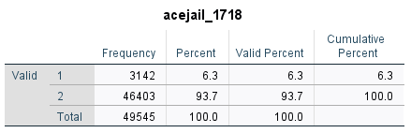
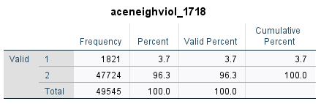
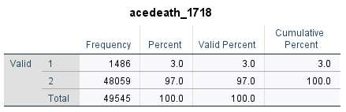
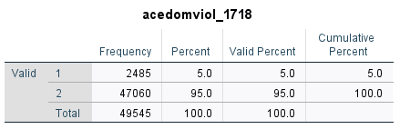

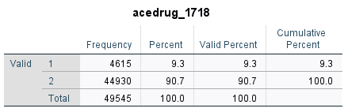
Frequencies
Most commonly endorsed ACE is drug use, then mental health, jail, domestic violence, neighborhood violence and death of parent

Slide 41
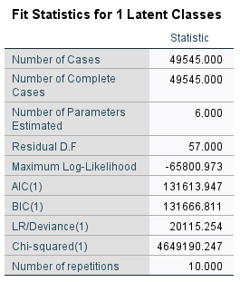
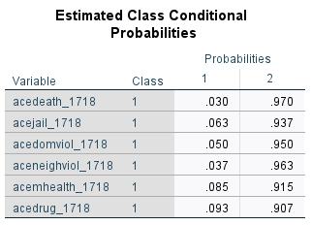
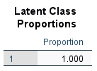
Fit Stats – 1C model
Notes:
NOTE: these are the same as the descriptive stats for each variable…

Slide 42
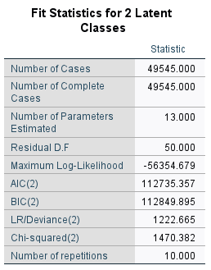
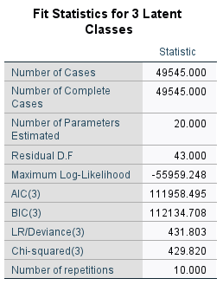

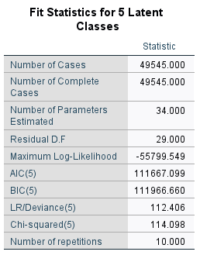


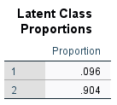
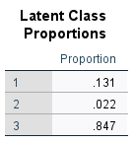
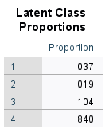
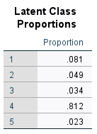
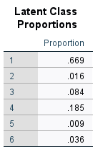
Fit Stats 2C – c-Class Models

Slide 43
Elbow Plot
You have to make your own elbow plot ☹

Slide 44
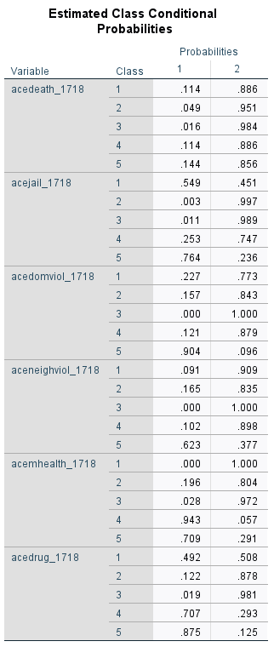
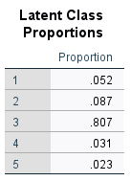
I first went with the 5-Class Model

Slide 45
 |  | Class 1 | Class 2 | Class 3 | Class 4 | Class 5
Death of Parent | Yes | .114 | .049 | .016 | .114 | .144
Death of Parent | No | .886 | .951 | .984 | .886 | .856
Jail/Incarceration of Parent | Yes | .549 | .003 | .011 | .253 | .764
Jail/Incarceration of Parent | No | .451 | .997 | .989 | .747 | .236
Domestic Violence | Yes | .227 | .157 | .000 | .121 | .904
Domestic Violence | No | .733 | .843 | 1.000 | .879 | .096
Neighborhood Violence | Yes | .091 | .165 | .000 | .102 | .623
Neighborhood Violence | No | .909 | .835 | 1.000 | .898 | .377
Mental Health | Yes | .000 | .196 | .028 | .943 | .709
 | No | 1.000 | .804 | .972 | .057 | .291
Substance Use | Yes | .492 | .122 | .019 | .707 | .875
 | No | .508 | .878 | .981 | .293 | .125
Class 1: Jail/Substance Use with some domestic violence
Class 2: Low Aces
Class 3: No Aces
Class 4: Mental Health/Substance Use
Class 5: High ACEs
Classes are not well separated
Notes:
Note: two classes overlap and can be considered ‘low/no’ Aces and so I went with the four class model before settling on the 3 class model
There is better separation in the 3 class model

Slide 46
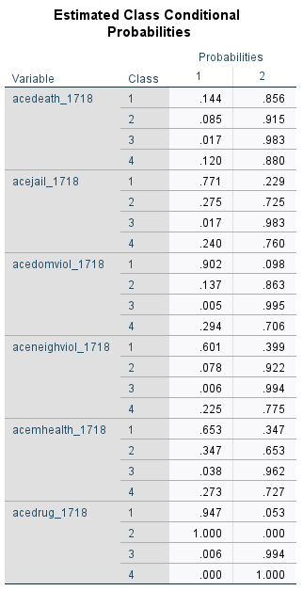
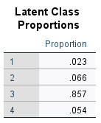

Slide 47
Comparison between 4 and 5 Classes
There are overlapping classes so we re-estimate with 1 fewer class
Put plot of 4 and 5 classes here

Slide 48
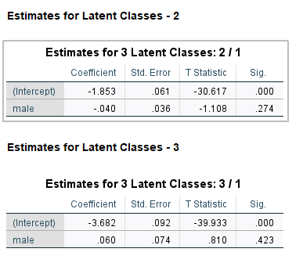
3-Class Model and Gender as covariate
 |  | Class 1 HIGH ACES 2.2% | Class 2 No ACES 84.7% | Class 3 Subs Use/Mental Health 13.1%
Death of Parent | Yes | .146 | .017 | .096
Death of Parent | No | .854 | .983 | .904
Jail/Incarceration of Parent | Yes | .787 | .013 | .268
Jail/Incarceration of Parent | No | .213 | .987 | .732
Domestic Violence | Yes | .936 | .007 | .180
Domestic Violence | No | .064 | .993 | .820
Neighborhood Violence | Yes | .629 | .008 | .121
Neighborhood Violence | No | .371 | .992 | .879
Mental Health | Yes | .664 | .032 | .329
 | No | .336 | .968 | .671
Substance Use | Yes | .876 | .008 | .514
 | No | .124 | .992 | .486
Notes:
IF YOU ARE CONFUSED REMEMBER THAT WITHIN THE CLASS, EACH VARIABLE RESPONSE PROBABILITIES MUST SUM TO 1

Slide 49

Warning
Every time you run the model the classes are randomized and so its possible that the classes will be in a different order on subsequent runs
The results will be the same
Pay attention to the order of classes when you run your models

Slide 50
Example from my work: substantive differences between classes (i.e., not degree)

Slide 51
The Sum Score, “ACE” Score or Cumulative Risk Score (“CR”)
The co-occurring nature of ACEs has led to the use of an “ACE score,” which represents the total number of ACE categories designed to measure CR
The ACE score (i.e., CR approach) has vastly improved our knowledge about the pervasive and detrimental effects of multiple forms of early childhood adversity
Negative sequelae of cumulative ACE burden (40 + years)
Depression (Chapman, Dube, & Anda, 2007)
Alcohol abuse (Dube et al., 2001)
HIV risk-taking behavior (Bensley, Van Eenwyk, & Simmons, 2000)

Slide 52
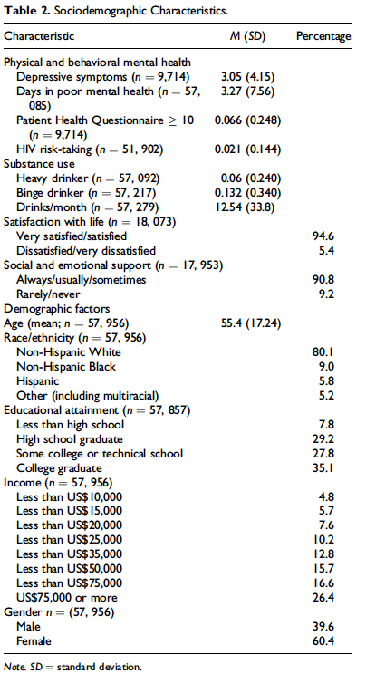
Sample Characteristics of the BRFSS
The sample is predominantly white, highly educated, wealthy and majority female
Should we think about group invariance?
Notes:
On average, respondents were 55.4 years old, tended to be satisfied with their lives, have high levels of emotional and social support and predominantly white, highly educated, wealthy and majority female.
The representativeness of this sample is obviously limited by these characteristics …

Slide 53
Methodological Limitations of the ACE Sum Score
Additivity
Multiplicity
Does 2 + 2 = 4 or 5?
Is 3 > 4 or 4 > 3?
Does marginal cost = 0?
Does “2” = “2”
Does the risk of 1 ACE depend on the risk of another?
Which of the 2^{x} permutations are children experiencing and in what ways does it matter in the long-term? → the LCA question!

Slide 54
Adverse Child Experiences and the Multiple Contexts of Child Development: Justifying a Latent Class Analysis
Relational/Family (e.g., Parental Support
Individual (e.g., Age, Gender)
Society
Community (e.g., Neighborhood Resources)
Reciprocal interactions between developing child and her environment
Any one risk factor has limited explanatory power over the identification of ‘constellations of risk’
The processes undergirding CR are conditional on the pattern of interactions between the child and the broader environment in which he or she exists.
Principles of multi- and equ- finality
Sociological Model of ACEs

Slide 55
Rethinking ACEs: Typologies of Adversity Using Latent Class Analysis (“LCA”)
LCA
Identifies homogenous population subgroups with similar constellations of ACE risk rather than relying on a priori cut points of CR
Allows for the interpretation of nonadditive and higher order interactions among risk factors
Does not treat risk factors as interchangeable, and
Provides new insights into the multiplicative effects of risks at different ecological levels

Slide 56

RESEARCH GOALS
How do the ACEs group together and how many groups can be identified?
Are there differences in CR across groupings of ACEs?
Do the groups differentially predict behavioral and mental health outcomes in adulthood?

Slide 57
Sample Characteristics of the BRFSS
The sample is predominantly white, highly educated, wealthy and majority female

Slide 58
ACES
BRFSS Adverse Childhood Experience (ACE) Module All questions refer to the time period before you were 18 years of age.
Question Wording | n (%) | Response | Coding
Did you live with anyone who
1. was depressed, mentally ill, or suicidal? | 57,437 (15.7) | 1=Yes 2=No 7=DK/NS 9=Refused | 0 = No 1 = Yes 7, 9 = missing
2. was a problem drinker or alcoholic? | 57,646 (23.6)
3. abused prescription medications? | 57,665 (7.7)
4. served time or was sentenced to serve time in a prison, jail, or other correctional facility? | 57,788 (4.9)
5. Were your parents never married, separated or divorced? | 57,219 (21.0) | 1=Yes 2=No 8=Parents not married 7=DK/NS 9=Refused | 1 = divorced, separated, never married 0 = not divorced, separated or married
How often did your parents or adults in your home ever: |  | 1=Never 2=Once 3=More than once 7=DK/NS 9=Refused | 0 = never 1 = one or more times
6. slap, hit, kick, punch or beat each other up? | 57,019 (14.9)
7. hit, beat, kick, or physically hurt you in any way? Do not include spanking | 57,468 (15.3)
8. swore at you, insulted you, or put you down? | 57,103 (31.5)
How often did anyone at least 5 years older than you or an
9. adult, ever touch you sexually? | 57,272 (10.3)
10. try to make you touch them sexually? | 57,320 (7.1)
11. force you to have sex? | 57,329 (4.0)

Slide 59
Multiple Exposure and Cumulative Impact
ACE Category | NONE | ≥1 | ≥2 | ≥3 | ≥4 | ≥5
Child Victimization
Emotional | 25 | 75 | 53 | 36 | 22 | 14
Physical | 9 | 91 | 75 | 58 | 41 | 27
Sexual Touching (Youth to adult) | 11 | 89 | 71 | 55 | 40 | 29
Sexual Touching (Adult to youth) | 4 | 96 | 80 | 63 | 48 | 37
Forced Intercourse | 3 | 97 | 92 | 78 | 65 | 50
Household Traumas
Parental Divorce/Separation | 29 | 71 | 53 | 38 | 26 | 17
Alcohol Abuse | 28 | 72 | 49 | 33 | 21 | 13
Drug Abuse | 9 | 91 | 75 | 57 | 42 | 30
Mental illness | 20 | 80 | 59 | 41 | 28 | 18
Domestic Violence | 10 | 90 | 73 | 55 | 38 | 25
Parental Incarceration | 13 | 87 | 74 | 59 | 46 | 30

Slide 60
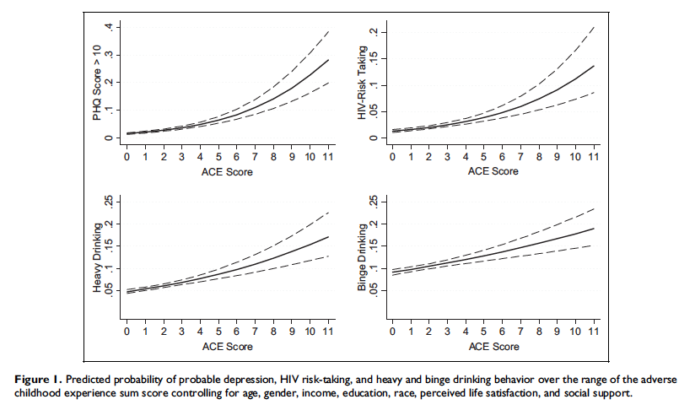
Notes:
This plot shows the sum score on the x-axis and different outcomes on the y-axis including PHQ score which is a measure of depressive symptoms, HIV risk taking behavior such as sharing needles and not wearing a condom, and problem drinking.
In all cases, as ACE score increases, the probability of endorsing these negative behaviors increases as well.
For example, the probability of a PHQ score greater than 10 (clinically relevant depression) is around .3 for respondents with 11 ACEs.
In contrast, individuals with no ACEs have a 0 probability of a PHQ score greater than 10.

Slide 61
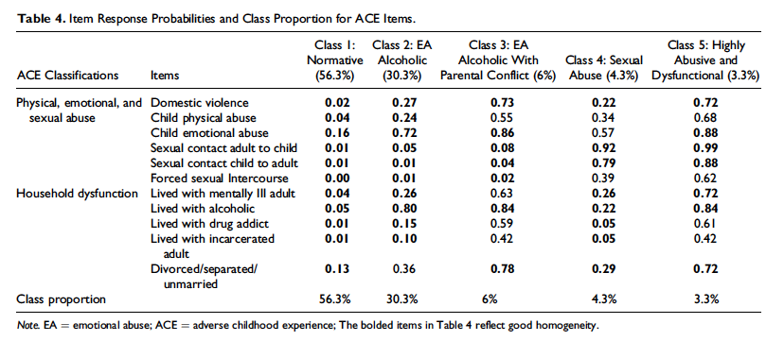

Slide 62
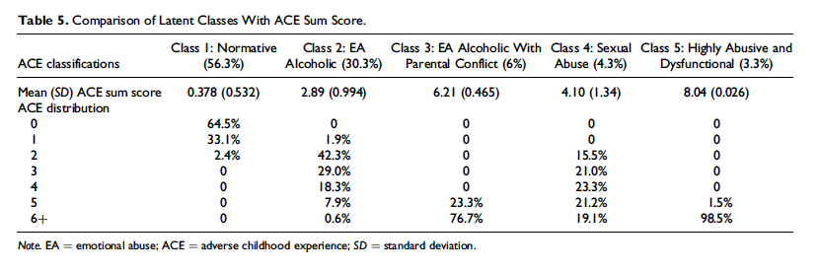
The takeaway here is that individuals in each class have different distributions of sum scores and within each of the types of household the number of ACEs that people experience is quite variable. Youth with a sum score of 5 for example, are equally likely to be in class 3 or class 4 but have not had the same experiences growing up
Notes:
Here we have the Latent Classes compared to the ACE sum score.
Focusing on the first row, we see that the 56.3% of youth in the low adversity, or normative class, have less than 1 ACE on average.
The 30.3% of youth living in the emotionally abusive alcoholic class have about 2.89 ACEs on average, etc.
The chart also shows the ACE distribution for each class.
Focusing on the columns we see that 64.5% of youth in the normative class have no ACEs whereas 33.1% have 1 and 2.4% have 2.
None of the youth in the low adversity class have 3 or more ACEs.
The takeaway here is that individuals in each class have different distributions of sum scores and within each of the types of household the number of ACEs that people experience is quite variable. Youth with a sum score of 5 for example, are equally likely to be in class 3 or class 4, but have not had nearly the same experiences growing up.

